Slide 1
Linear Algebra for Communications:
A gentle introduction
Shivkumar Kalyanaraman
Linear Algebra has become as basic and as applicable
as calculus, and fortunately it is easier.
--Gilbert Strang, MIT

Slide 2
Outline
What is linear algebra, really? Vector? Matrix? Why care?
Basis, projections, orthonormal basis
Algebra operations: addition, scaling, multiplication, inverse
Matrices: translation, rotation, reflection, shear, projection etc
  Symmetric/Hermitian, positive definite matrices
Decompositions:
  Eigen-decomposition: eigenvector/value, invariants
  Singular Value Decomposition (SVD).
Sneak peeks: how do these concepts relate to communications ideas: fourier transform, least squares, transfer functions, matched filter, solving differential equations etc

Slide 3
What is “Linear” & “Algebra”?
Properties satisfied by a line through the origin (“one-dimensional case”.
  A directed arrow from the origin (v) on the line, when scaled by a constant (c) remains on the line
  Two directed arrows (u and v) on the line can be “added” to create a longer directed arrow (u + v) in the same line.
Wait a minute! This is nothing but arithmetic with symbols!
  “Algebra”: generalization and extension of arithmetic.
  “Linear” operations: addition and scaling.
Abstract and Generalize !
  “Line” ↔ vector space having N dimensions
  “Point” ↔ vector with N components in each of the N dimensions (basis vectors).
    Vectors have: “Length” and “Direction”.
    Basis vectors: “span” or define the space & its dimensionality.
  Linear function transforming vectors ↔ matrix.
    The function acts on each vector component and scales it
    Add up the resulting scaled components to get a new vector!
    In general: f(cu + dv) = cf(u) + df(v)
y
cv
v
x
y
u
v
u + v
x

Slide 4
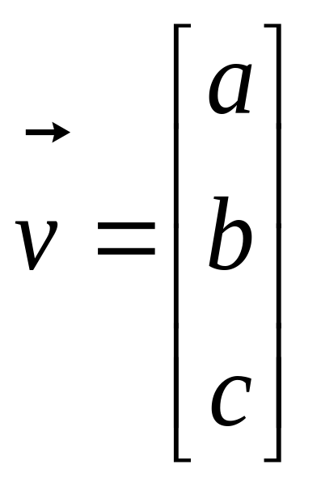
What is a Vector ?
Think of a vector as a directed line segment in N-dimensions! (has “length” and “direction”)
Basic idea: convert geometry in higher dimensions into algebra!
  Once you define a “nice” basis along each dimension: x-, y-, z-axis …
  Vector becomes a 1 x N matrix!
  v = [a b c]^{T}
  Geometry starts to become linear algebra on vectors like v!
y
v
x

Slide 5
Examples of Geometry becoming Algebra
Lines are vectors through the origin, scaled and translated: mx + c
  Intersection of lines can be modeled as addition of vectors: solution of linear equations.
Linear transformations of vectors can be associated with a matrix A, whose columns represent how each basis vector is transformed.
Ellipses and conic sections:
  ax² + 2bxy + cy² = d
  Let x = [x y]^{T} and A is a symmetric matrix with rows [a b]^{T} and [b c]^{T}
  x^{T}Ax = c {quadratic form equation for ellipse!}
    This becomes convenient at higher dimensions
  Note how a symmetric matrix A naturally arises from such a homogenous multivariate equation…

Slide 6
Scalar vs Matrix Equations
Line equation: y = mx + c
Matrix equation: y = Mx + c
Second order equations:
  x^{T}Mx = c
  y = (x^{T}Mx)u + Mx
  … involves quadratic forms like x^{T}Mx

Slide 7
Vector Addition: A+B
A+B
A
A+B = C
(use the head-to-tail method to combine vectors)
B
C
B
A

Slide 8
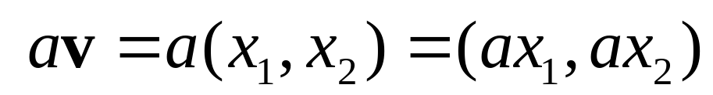
Scalar Product: av
av
v
Change only the length (“scaling”), but keep direction fixed.
Sneak peek: matrix operation (Av) can change length,
direction and also dimensionality!

Slide 9
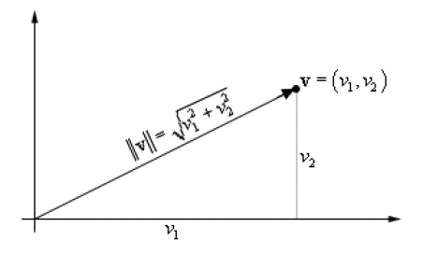
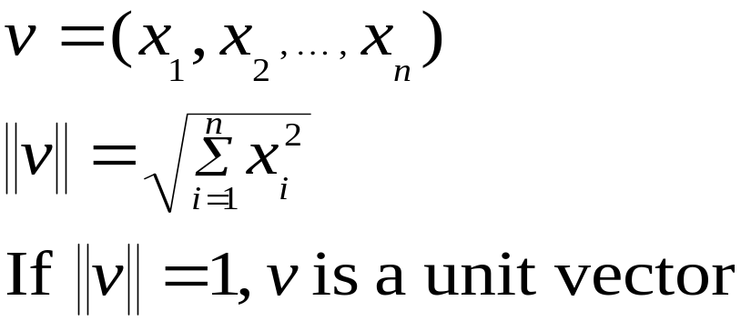
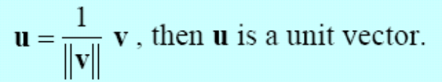
Vectors: Magnitude (Length) and Phase (direction)
T
(Magnitude or “2-norm”)
(unit vector => pure direction)
Alternate representations:
Polar coords: (||v||, θ)
Complex numbers: ||v||e^{jθ}
y
||v||
θ
“phase”
x

Slide 10
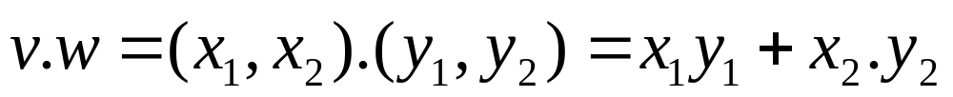
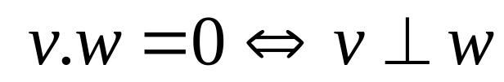
Inner (dot) Product: v.w or w^{T}v
v
α
w
The inner product is a SCALAR!
If vectors v, w are “columns”, then dot product is w^{T}v

Slide 11
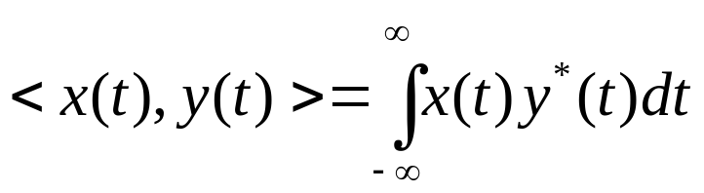


Inner Products, Norms: Signal space
Signals modeled as vectors in a vector space: “signal space”
To form a signal space, first we need to know the inner product between two signals (functions):
  Inner (scalar) product: (generalized for functions)
  Properties of inner product:
= cross-correlation between x(t) and y(t)

Slide 12
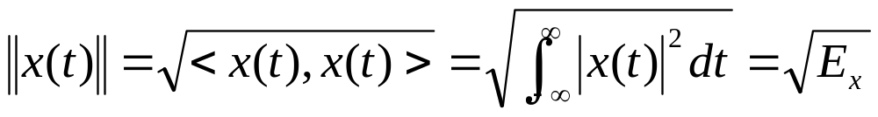
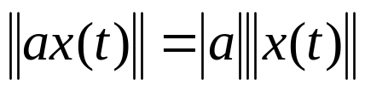
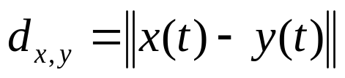
Signal space …
The distance in signal space is measure by calculating the norm.
What is norm?
  Norm of a signal (generalization of “length”):
  Norm between two signals:
We refer to the norm between two signals as the Euclidean distance between two signals.
= “length” of x(t)

Slide 13












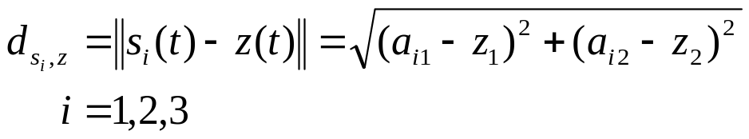
Example of distances in signal space
Detection in
AWGN noise:
Pick the “closest”
signal vector
The Euclidean distance between signals z(t) and s(t):

Slide 14
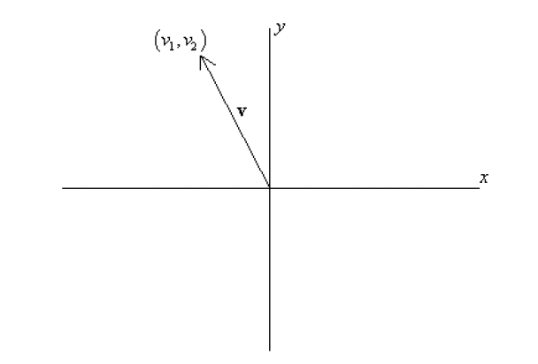
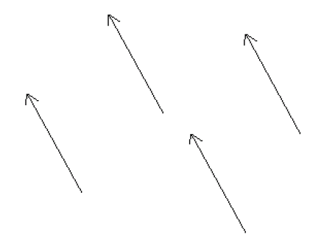
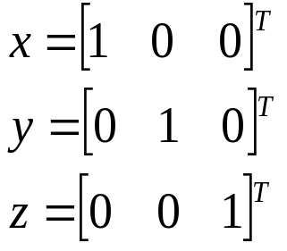
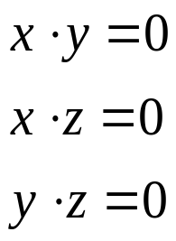
Bases & Orthonormal Bases
Basis (or axes): frame of reference
vs
Basis: a space is totally defined by a set of vectors – any point is a linear combination of the basis
Ortho-Normal: orthogonal + normal
[Sneak peek:
Orthogonal: dot product is zero
Normal: magnitude is one ]

Slide 15
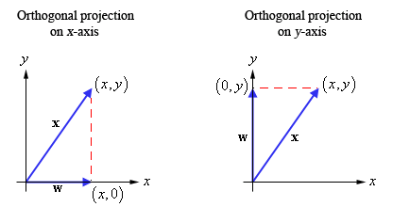
Projections w/ Orthogonal Basis
Get the component of the vector on each axis:
  dot-product with unit vector on each axis!
Sneak peek: this is what Fourier transform does!
Projects a function onto a infinite number of orthonormal basis functions: (e^{jω} or e^{j2πnθ}), and adds the results up (to get an equivalent “representation” in the “frequency” domain).
CDMA codes are “orthogonal”, and projecting the composite received signal on each code helps extract the symbol transmitted on that code.

Slide 16

Orthogonal Projections: CDMA, Spread Spectrum
spread spectrum
Base-band Spectrum
Radio Spectrum
Code B
B
Code A
B
Frequency
Code A
A
A
B
C
C
C
A
B
B
B
A
A
A
C
B
Sender
Time
Receiver
Each “code” is an orthogonal basis vector => signals sent are orthogonal

Slide 17

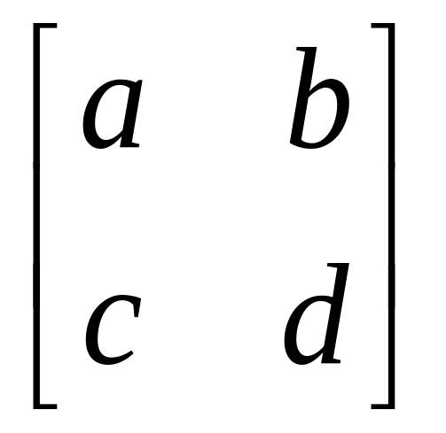
What is a Matrix?
A matrix is a set of elements, organized into rows and columns
rows
columns

Slide 18
What is a Matrix? (Geometrically)
Matrix represents a linear function acting on vectors:
  Linearity (a.k.a. superposition): f(au + bv) = af(u) + bf(v)
f transforms the unit x-axis basis vector i = [1 0]^{T} to [a c]^{T}
f transforms the unit y-axis basis vector j = [0 1]^{T} to [b d]^{T}
f can be represented by the matrix with [a c]^{T} and [b d]^{T} as columns
  Why? f(w = mi + nj) = A[m n]^{T}
Column viewpoint: focus on the columns of the matrix!
[0,1]^{T}
[a,c]^{T}
[1,0]^{T}
[b,d]^{T}
Linear Functions f : Rotate and/or stretch/shrink the basis vectors

Slide 19
Matrix operating on vectors
Matrix is like a function that transforms the vectors on a plane
Matrix operating on a general point => transforms x- and y-components
System of linear equations: matrix is just the bunch of coeffs !
x’ = ax + by
y’ = cx + dy
Vector (column) viewpoint:
  New basis vector [a c]^{T} is scaled by x, and added to:
  New basis vector [b d]^{T} scaled by y
  i.e. a linear combination of columns of A to get [x’ y’]^{T}
For larger dimensions this “column” or vector-addition viewpoint is better than the “row” viewpoint involving hyper-planes (that intersect to give a solution of a set of linear equations)
⎡
a
b
⎤
⎡
x
⎤
⎡
x
'
⎤
=
⎢
⎥
⎢
⎥
⎢
⎥
⎣
c
d
⎦
⎣
y
⎦
⎣
y
'
⎦

Slide 20
Vector Spaces, Dimension, Span
Another way to view Ax = b, is that a solution exists for all vectors b that lie in the “column space” of A,
  i.e. b is a linear combination of the basis vectors represented by the columns of A
  The columns of A “span” the “column” space
  The dimension of the column space is the column rank (or rank) of matrix A.
In general, given a bunch of vectors, they span a vector space.
  There are some “algebraic” considerations such as closure, zero etc
  The dimension of the space is maximal only when the vectors are linearly independent of the others.
  Subspaces are vector spaces with lower dimension that are a subset of the original space
Sneak Peek: linear channel codes (eg: Hamming, Reed-solomon, BCH) can be viewed as k-dimensional vector sub-spaces of a larger N-dimensional space.
  k-data bits can therefore be protected with N-k parity bits

Slide 21
Forward Error Correction (FEC):
Eg: Reed-Solomon RS(N,K)
>= K of N
received
Recover K data packets!
RS(N,K)
FEC (N-K)
Block
Size
(N)
Lossy Network
Data = K
This is linear algebra in action: design an appropriate
k-dimensional vector sub-space out of an
N-dimensional vector space

Slide 22
Matrices: Scaling, Rotation, Identity
Pure scaling, no rotation => “diagonal matrix” (note: x-, y-axes could be scaled differently!)
Pure rotation, no stretching => “orthogonal matrix” O
Identity (“do nothing”) matrix = unit scaling, no rotation!
r₁ 0
0 r₂
[0,1]^{T}
[0,r₂]^{T}
scaling
[1,0]^{T}
[r₁,0]^{T}
cosθ -sinθ
sinθ cosθ
[0,1]^{T}
[-sinθ, cosθ]^{T}
rotation
[cosθ, sinθ]^{T}
θ
[1,0]^{T}

Slide 23

Scaling
P’
P
a.k.a: dilation (r >1),
contraction (r <1)
r 0
0 r

Slide 24
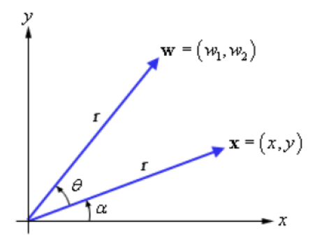
Rotation
P
P’
cosθ -sinθ
sinθ cosθ

Slide 25
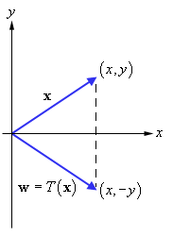

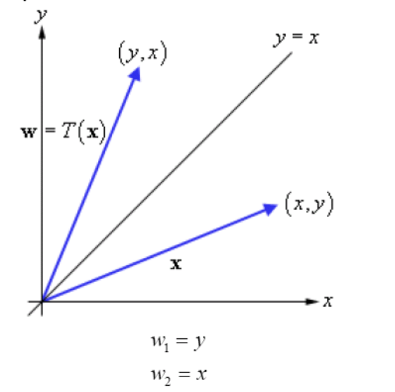
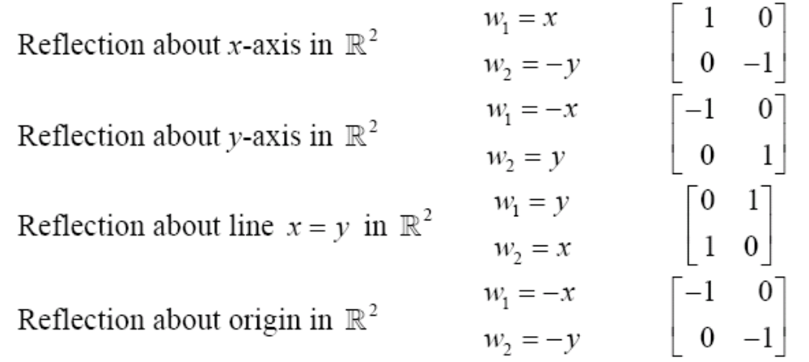
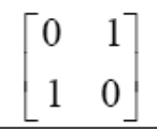
Reflections
Reflection can be about any line or point.
Complex Conjugate: reflection about x-axis (i.e. flip the phase θ to -θ)
Reflection => two times the projection distance from the line.
Reflection does not affect magnitude
Induced Matrix

Slide 26
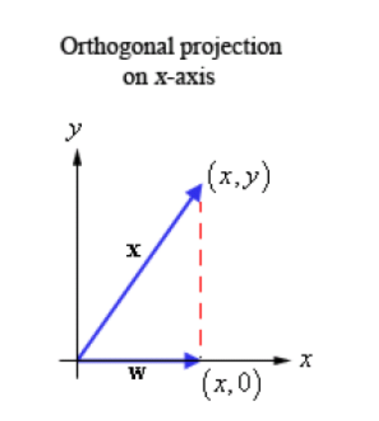
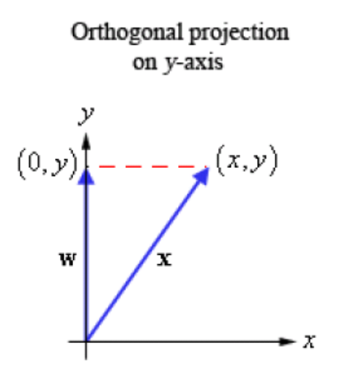
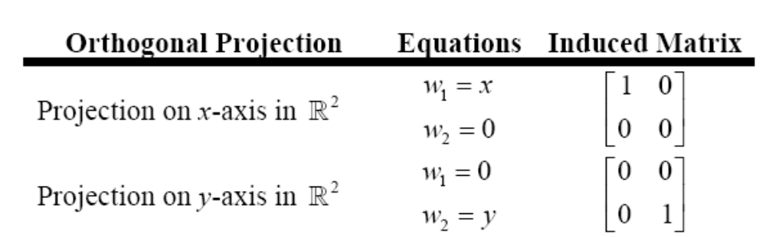
Orthogonal Projections: Matrices

Slide 27
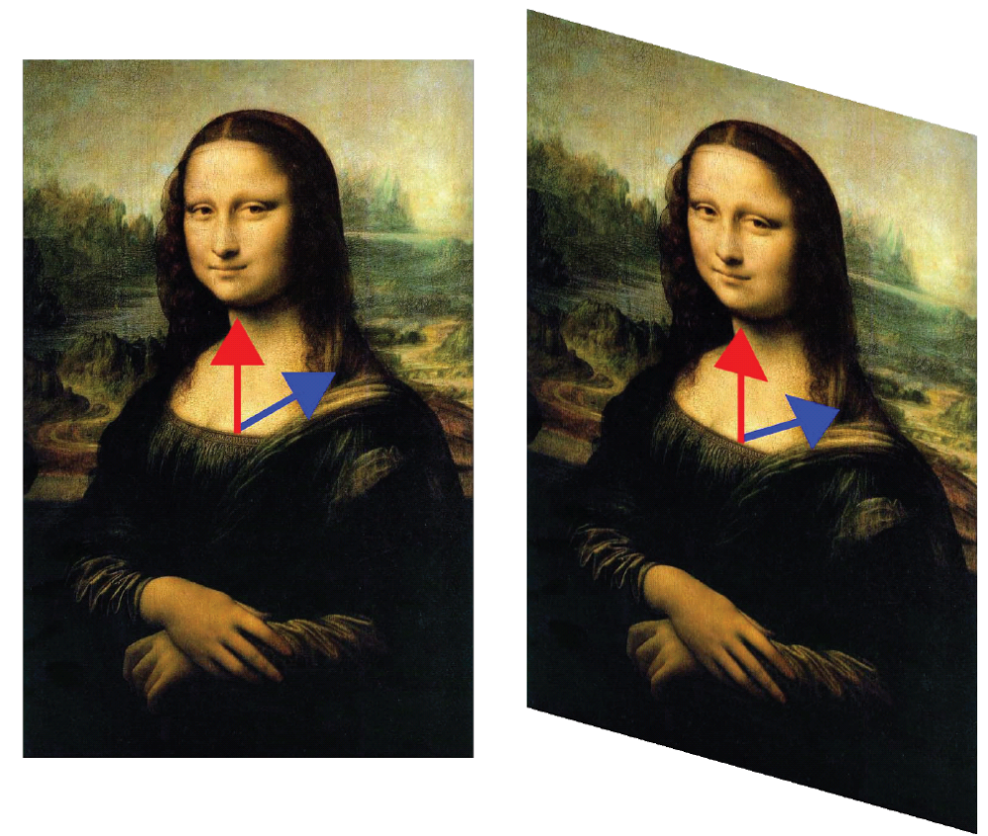
Shear Transformations
Hold one direction constant and transform (“pull”) the other direction
1 0
-0.5 1

Slide 28

2D Translation
P’
t
P
P’
ty
t
P
y
x
tx

Slide 29
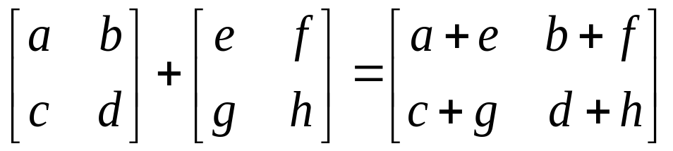
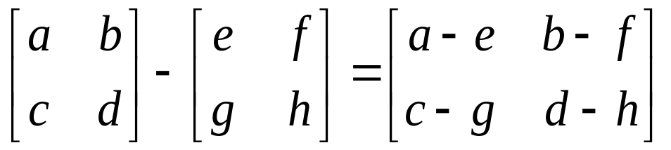
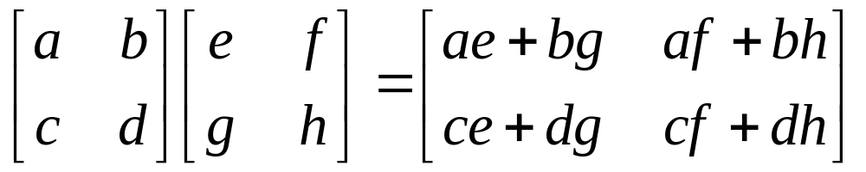
Basic Matrix Operations
Addition, Subtraction, Multiplication: creating new matrices (or functions)
Just add elements
Just subtract elements
Multiply each row by each column

Slide 30
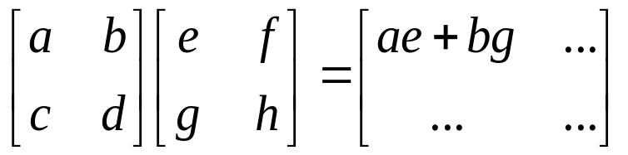
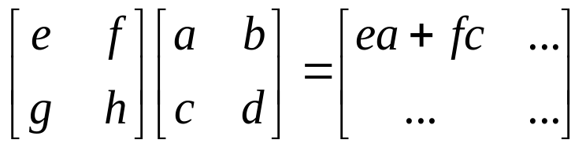
Multiplication
Is AB = BA? Maybe, but maybe not!
Matrix multiplication AB: apply transformation B first, and then again transform using A!
Heads up: multiplication is NOT commutative!
Note: If A and B both represent either pure “rotation” or “scaling” they can be interchanged (i.e. AB = BA)

Slide 31
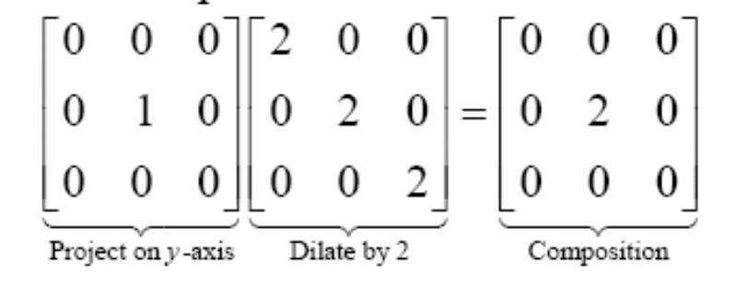
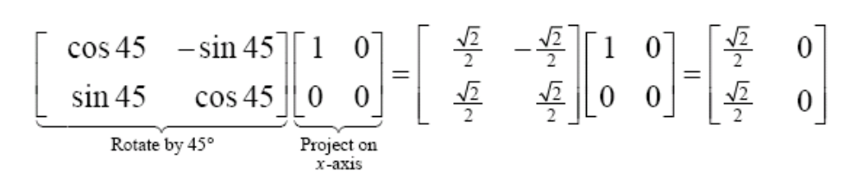
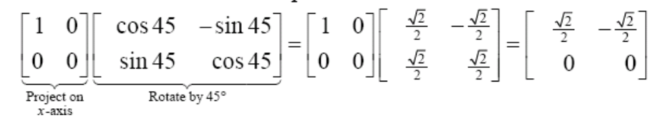
Multiplication as Composition…
Different!

Slide 32
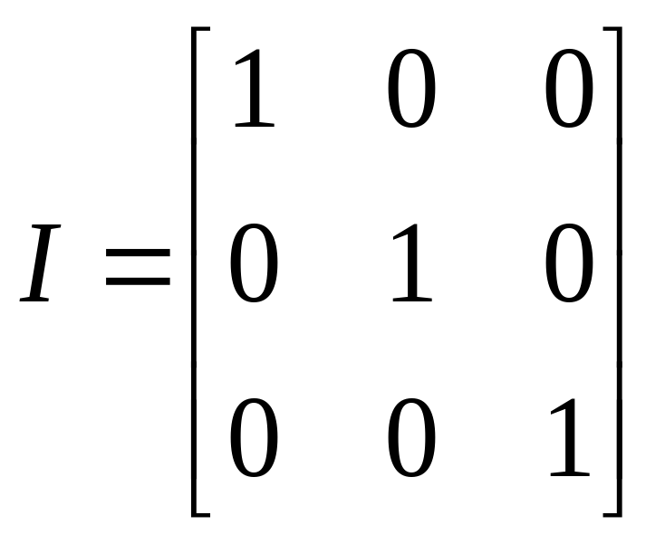
Inverse of a Matrix
Identity matrix:
AI = A
Inverse exists only for square matrices that are non-singular
  Maps N-d space to another N-d space bijectively
Some matrices have an inverse, such that:
AA⁻¹ = I
Inversion is tricky:
(ABC)⁻¹ = C⁻¹B⁻¹A⁻¹
Derived from non-commutativity property

Slide 33
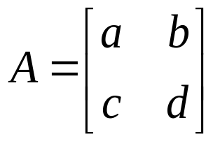
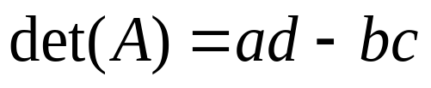
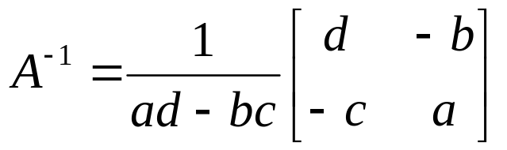

Determinant of a Matrix
Used for inversion
If det(A) = 0, then A has no inverse
Can be found using factorials, pivots, and cofactors!
“Volume” interpretation
Sneak Peek: Determinant-criterion for space-time code design.
  Good code exploiting time diversity should maximize the minimum product distance between codewords.
  Coding gain determined by min of determinant over code words.

Slide 34
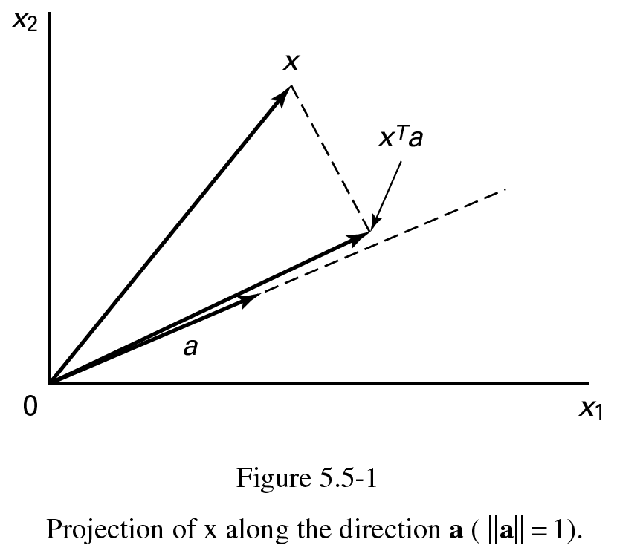
Projection: Using Inner Products (I)
p = a (a^{T}x)
||a|| = a^{T}a = 1

Slide 35
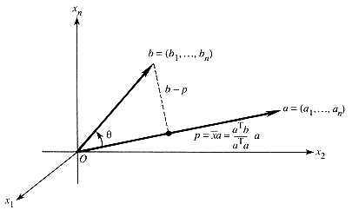
Projection: Using Inner Products (II)
p = a (a^{T}b)/ (a^{T}a)
Note: the “error vector” e = b-p
is orthogonal (perpendicular) to p.
i.e. Inner product: (b-p)^{T}p = 0
“Orthogonalization” principle: after projection, the difference or “error” is orthogonal to the projection
Sneak peek : we use this idea to find a “least-squares” line that minimizes the sum of squared errors (i.e. min Σe^{T}e).
This is also used in detection under AWGN noise to get the “test statistic”:
Idea: project the noisy received vector y onto (complex) transmit vector h: “matched” filter/max-ratio-combining (MRC)

Slide 36
Schwartz Inequality & Matched Filter
Inner Product (a^{T}x) <= Product of Norms (i.e. |a||x|)
  Projection length <= Product of Individual Lengths
This is the Schwartz Inequality!
  Equality happens when a and x are in the same direction (i.e. cosθ = 1, when θ = 0)
Application: “matched” filter
  Received vector y = x + w (zero-mean AWGN)
  Note: w is infinite dimensional
  Project y to the subspace formed by the finite set of transmitted symbols x: y’
  y’ is said to be a “sufficient statistic” for detection, i.e. reject the noise dimensions outside the signal space.
  This operation is called “matching” to the signal space (projecting)
  Now, pick the x which is closest to y’ in distance (ML detection = nearest neighbor)

Slide 37
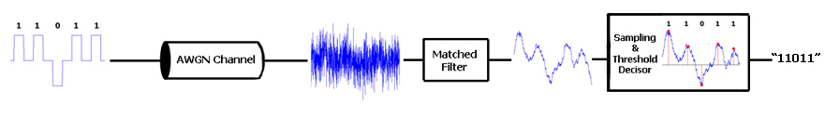
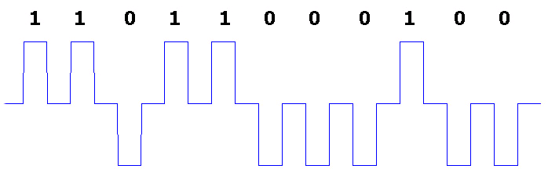

Matched Filter Receiver: Pictorially…
Transmitted Signal
Received Signal (w/ Noise)
Signal + AWGN noise will not reveal the original transmitted sequence.
There is a high power of noise relative to the power of the desired signal (i.e., low SNR).
If the receiver were to sample this signal at the correct times, the
resulting binary message would have a lot of bit errors.

Slide 38
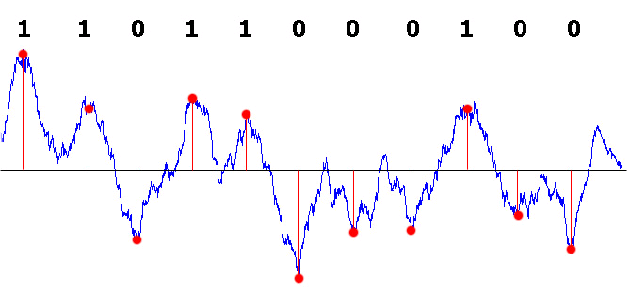
Matched Filter (Contd)
Consider the received signal as a vector r, and the transmitted signal vector as s
Matched filter “projects” the r onto signal space spanned by s (“matches” it)
Filtered signal can now be safely sampled by the receiver at the correct sampling instants,
resulting in a correct interpretation of the binary message
Matched filter is the filter that maximizes the signal-to-noise ratio it can be shown that it also minimizes the BER: it is a simple projection operation

Slide 39
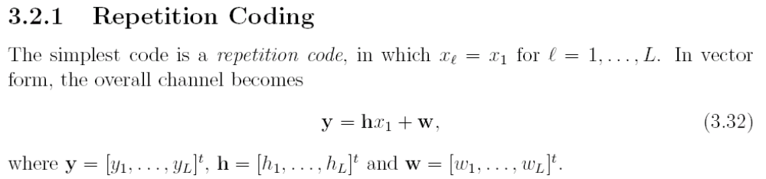
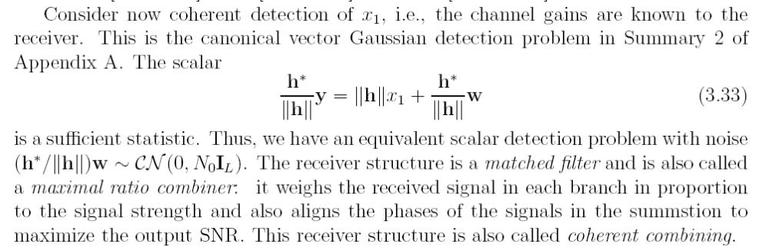
Matched Filter w/ Repetition Coding
hx₁ only spans a
1-dimensional space
||h||
Multiply by conjugate => cancel phase!

Slide 40
Symmetric, Hermitian, Positive Definite
Symmetric: A = A^{T}
  Symmetric => square matrix
Complex vectors/matrices:
  Transpose of a vector or a matrix with complex elements must involve a “conjugate transpose”, i.e. flip the phase as well.
  For example: ||x||² = x^{H}x, where x^{H} refers to the conjugate transpose of x
Hermitian (for complex elements): A = A^{H}
  Like symmetric matrix, but must also do a conjugation of each element (i.e. flip its phase).
  i.e. symmetric, except for flipped phase
  Note we will use A* instead of A^{H} for convenience
Positive definite: symmetric, and its quadratic forms are strictly positive, for non-zero x :
  x^{T}Ax > 0
  Geometry: bowl-shaped minima at x = 0

Slide 41
Orthogonal, Unitary Matrices: Rotations
Rotations and Reflections: Orthogonal matrices Q
  Pure rotation => Changes vector direction, but not magnitude (no scaling effect)
    Retains dimensionality, and is invertible
  Inverse rotation is simply Q^{T}
Unitary matrix (U): complex elements, rotation in complex plane
  Inverse: U^{H} (note: conjugate transpose).
Sneak peek:
  Gaussian noise exhibits “isotropy”, i.e. invariance to direction. So any rotation Q of a gaussian vector (w) yields another gaussian vector Qw.
  Circular symmetric (c-s) complex gaussian vector w => complex rotation w/ U yields another c-s gaussian vector Uw
Sneak peek: The Discrete Fourier Transform (DFT) matrix is both unitary and symmetric.
  DFT is nothing but a “complex rotation,” i.e. viewed in a basis that is a rotated version of the original basis.
  FFT is just a fast implementation of DFT. It is fundamental in OFDM.

Slide 42
Quadratic forms: x^{T}Ax
Linear:
  y = mx + c … generalizes to vector equation
  y = Mx + c (… y, x, c are vectors, M = matrix)
Quadratic expressions in 1 variable: x²
  Vector expression: x^{T}x (… projection!)
  Quadratic forms generalize this, by allowing a linear transformation A as well
Multivariable quadratic expression: x² + 2xy + y²
Captured by a symmetric matrix A, and quadratic form:
  x^{T}Ax
Sneak Peek: Gaussian vector formula has a quadratic form term in its exponent: exp[-0.5 (x -μ)^{T} K⁻¹ (x -μ)]
  Similar to 1-variable gaussian: exp(-0.5 (x -μ)²/σ² )
  K⁻¹ (inverse covariance matrix) instead of 1/ σ²
  Quadratic form involving (x -μ) instead of (x -μ)²

Slide 43
Rectangular Matrices
Linear system of equations:
  Ax = b
More or less equations than necessary.
  Not full rank
If full column rank, we can modify equation as:
  A^{T}Ax = A^{T}b
  Now (A^{T}A) is square, symmetric and invertible.
  x = (A^{T}A)⁻¹ A^{T}b … now solves the system of equations!
  This solution is called the least-squares solution. Project b onto column space and then solve.
(A^{T}A)⁻¹ A^{T} is sometimes called the “pseudo inverse”
Sneak Peek: (A^{T}A) or (A*A) will appear often in communications math (MIMO). They will also appear in SVD (singular value decomposition)
The pseudo inverse (A^{T}A)⁻¹ A^{T} will appear in decorrelator receivers for MIMO
More: http://tutorial.math.lamar.edu/AllBrowsers/2318/LeastSquares.asp
  (or Prof. Gilbert Strang’s (MIT) videos on least squares, pseudo inverse):

Slide 44
Invariants of Matrices: Eigenvectors
Consider a NxN matrix (or linear transformation) T
An invariant input x of a function T(x) is nice because it does not change when the function T is applied to it.
  i.e. solve this eqn for x: T(x) = x
We allow (positive or negative) scaling, but want invariance w.r.t direction:
  T(x) = λx
There are multiple solutions to this equation, equal to the rank of the matrix T. If T is “full” rank, then we have a full set of solutions.
These invariant solution vectors x are eigenvectors, and the “characteristic” scaling factors associated w/ each x are eigenvalues.
E-vectors:
- Points on the x-axis unaffected [1 0]^{T}
Points on y-axis are flipped [0 1]^{T}
(but this is equivalent to scaling by -1!)
E-values: 1, -1 (also on diagonal of matrix)

Slide 45
Eigenvectors (contd)
Eigenvectors are even more interesting because any vector in the domain of T can now be …
  … viewed in a new coordinate system formed with the invariant “eigen” directions as a basis.
  The operation of T(x) is now decomposable into simpler operations on x,
  … which involve projecting x onto the “eigen” directions and applying the characteristic (eigenvalue) scaling along those directions
Sneak Peek:
In fourier transforms (associated w/ linear systems):
  The unit length phasors e^{jω} are the eigenvectors! And the frequency response are the eigenvalues!
  Why? Linear systems are described by differential equations (i.e. d/dω and higher orders)
    Recall d (e^{jω})/dω = je^{jω}
    j is the eigenvalue and e^{jω} the eigenvector (actually, an “eigenfunction”)

Slide 46

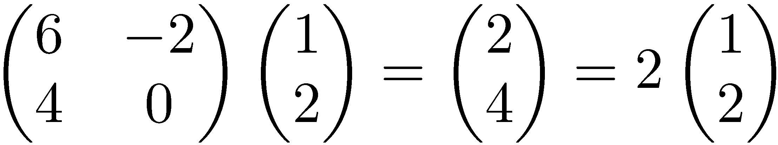
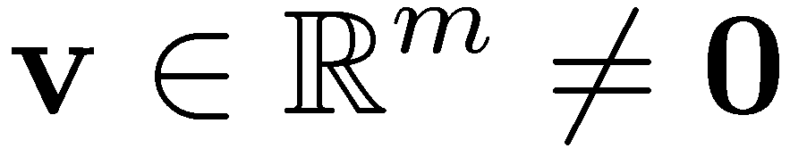

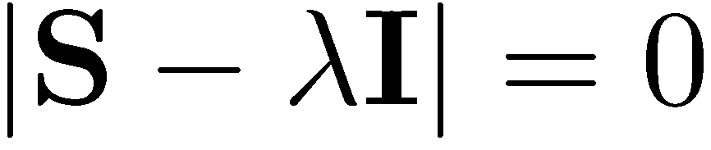
Eigenvalues & Eigenvectors
Eigenvectors (for a square m×m matrix S)
How many eigenvalues are there at most?
Example
(right) eigenvector
eigenvalue
only has a non-zero solution if
this is a m-th order equation in λ which can have at most m distinct solutions (roots of the characteristic polynomial) – can be complex even though S is real.

Slide 47
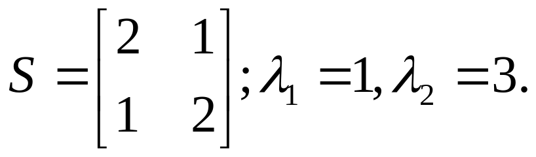





Diagonal (Eigen) decomposition – (homework)
Let
The eigenvectors and form
Recall
UU^{–1} =1.
Inverting, we have
Then, S=UΛU^{–1} =

Slide 48


Example (homework)
Let’s divide U (and multiply U^{–1}) by
Then, S=
Q
Λ
(Q⁻¹= Q^{T} )

Slide 49





Geometric View: EigenVectors
Homogeneous (2nd order) multivariable equations:
Represented in matrix (quadratic) form w/ symmetric matrix A:
        where
Eigenvector decomposition:
Geometry: Principal Axes of Ellipse
Symmetric A => orthogonal e-vectors!
Same idea in fourier transforms
  E-vectors are “frequencies”
Positive Definite A => +ve real e-values!

Slide 50
Why do Eigenvalues/vectors matter?
Eigenvectors are invariants of A
  Don’t change direction when operated A
Recall d(e^{λt})/dt = λe^{λt} .
  e^{λt} is an invariant function for the linear operator d/dt, with eigenvalue λ
Pair of differential eqns:
  dv/dt = 4v – 5u
  du/dt = 2u – 3w
Can be written as: dy/dt = Ay, where y = [v u]^{T}
  y = [v u]^{T} at time 0 = [8 5]^{T}
Substitute y = e^{λt}x into the equation dy/dt = Ay
  λe^{λt}x = Ae^{λt}x
  This simplifies to the eigenvalue vector equation: Ax = λx
Solutions of multivariable differential equations (the bread-and-butter in linear systems) correspond to solutions of linear algebraic eigenvalue equations!

Slide 51
Eigen Decomposition
Every square matrix A, with distinct eigenvalues has an eigen decomposition:
  A = SΛS⁻¹
  … S is a matrix of eigenvectors and
  … Λ is a diagonal matrix of distinct eigenvalues Λ = diag(λ₁, … λ_{N})
Follows from definition of eigenvector/eigenvalue:
  Ax = λx
  Collect all these N eigenvectors into a matrix (S):
    AS = SΛ.
    or, if S is invertible (if e-values are distinct)…
  => A = SΛS⁻¹

Slide 52
Eigen decomposition: Symmetric A
Every square, symmetric matrix A can be decomposed into a product of a rotation (Q), scaling (Λ) and an inverse rotation (Q^{T})
  A = QΛQ^{T}
  Idea is similar … A = SΛS⁻¹
  But the eigenvectors of a symmetric matrix A are orthogonal and form an orthogonal basis transformation Q.
  For an orthogonal matrix Q, inverse is just the transpose Q^{T}
This is why we love symmetric (or hermitian) matrices: they admit nice decomposition
  We love positive definite matrices even more: they are symmetric and all have all eigenvalues strictly positive.
  Many linear systems are equivalent to symmetric/hermitian or positive definite transformations.

Slide 53
Fourier Methods ≡ Eigen Decomposition!
Applying transform techniques is just eigen decomposition!
Discrete/Finite case (DFT/FFT):
  Circulant matrix C is like convolution. Rows are circularly shifted versions of the first row
  C = FΛF* where F is the (complex) fourier matrix, which happens to be both unitary and symmetric, and multiplication w/ F is rapid using the FFT.
  Applying F = DFT, i.e. transform to frequency domain, i.e. “rotate” the basis to view C in the frequency basis.
  Applying Λ is like applying the complex gains/phase changes to each frequency component (basis vector)
  Applying F* inverts back to the time-domain. (IDFT or IFFT)

Slide 54




Fourier /Eigen Decomposition (Continued)
Continuous case:
  Any function f(t) can be viewed as a integral (sum) of scaled, time-shifted impulses ∫c(τ)δ(t+τ) dτ
  h(t) is the response the system gives to an impulse (“impulse response”).
  Function’s response is the convolution of the function f(t) w/ impulse response h(t): for linear time-invariant systems (LTI): f(t)*h(t)
  Convolution is messy in the time-domain, but becomes a multiplication in the frequency domain: F(s)H(s)
Input
Output
Linear system

Slide 55
Fourier /Eigen Decomposition (Continued)
Transforming an impulse response h(t) to frequency domain gives H(s), the characteristic frequency response. This is a generalization of multiplying by a fourier matrix F
  H(s) captures the eigen values (i.e scaling) corresponding to each frequency component s.
  Doing convolution now becomes a matter of multiplying eigenvalues for each frequency component;
    and then transform back (i.e. like multiplying w/ IDFT matrix F*)
The eigenvectors are the orthogonal harmonics, i.e. phasors e^{ikx}
  Every harmonic e^{ikx} is an eigen function of every derivative and every finite difference, which are linear operators.
  Since dynamic systems can be written as differential/difference equations, eigen transform methods convert them into simple polynomial equations!

Slide 56
Applications in Random Vectors/Processes
Covariance matrix K for random vectors X:
  Generalization of variance, K_{ij} is the “co-variance” between components x_{i} and x_{j}
  K = E[(X -μ)(X -μ)^{T}]
  K_{ij} = K_{ji:} => K is a real, symmetric matrix, with orthogonal eigenvectors!
  K is positive semi-definite. When K is full-rank, it is positive definite.
“White” => no off-diagonal correlations
  K is diagonal, and has the same variance in each element of the diagonal
  Eg: “Additive White Gaussian Noise” (AWGN)
  Whitening filter: eigen decomposition of K + normalization of each eigenvalue to 1!
(Auto)Correlation matrix R = E[XX^{T}]
R.vectors X, Y “uncorrelated” => E[XY^{T}] = 0. “orthogonal”

Slide 57



Gaussian Random Vectors
Linear transformations of the standard gaussian vector:
pdf: has covariance matrix K = AA^{t} in the quadratic form instead of σ²
When the covariance matrix K is diagonal, i.e., the component random variables are uncorrelated. Uncorrelated + gaussian => independence.
  “White” gaussian vector => uncorrelated, or K is diagonal
  Whitening filter => convert K to become diagonal (using eigen-decomposition)
Note: normally AWGN noise has infinite components, but it is projected onto a finite signal space to become a gaussian vector

Slide 58





Singular Value Decomposition (SVD)
Like the eigen-decomposition, but for ANY matrix!
(even rectangular, and even if not full rank)!
0
0
ρ: rank of A
U (V): orthogonal matrix containing the left (right) singular vectors of A.
S: diagonal matrix containing the singular values of A.
σ₁ ¸ σ₂ ¸ … ¸ σ_{ρ} : the entries of Σ.
Singular values of A (i.e. σ_{i}) are related (see next slide)
to the eigenvalues of the square/symmetric matrices A^{T}A and AA^{T}

Slide 59



Singular Value Decomposition
For an m× n matrix A of rank r there exists a factorization
(Singular Value Decomposition = SVD) as follows:
m×m
m×n
V is n×n
The columns of U are orthogonal eigenvectors of AA^{T}.
The columns of V are orthogonal eigenvectors of A^{T}A.
Eigenvalues λ₁ … λ_{r} of AA^{T} are the eigenvalues of A^{T}A.
Singular values.

Slide 60

SVD, intuition
Let the blue circles represent m data points in a 2-D Euclidean space.
Then, the SVD of the m-by-2 matrix of the data will return …
2nd (right) singular vector
1st (right) singular vector:
direction of maximal variance,
2nd (right) singular vector:
direction of maximal variance, after removing the projection of the data along the first singular vector.
1st (right) singular vector

Slide 61
Singular Values
2nd (right) singular vector
σ₂
σ₁: measures how much of the data variance is explained by the first singular vector.
σ₂: measures how much of the data variance is explained by the second singular vector.
σ₁
1st (right) singular vector

Slide 62






SVD for MIMO Channels
MIMO (vector) channel:
SVD:
Rank of H is the number of non-zero singular values
H*H = VΛ^{t}ΛV*
Change of variables:
Transformed MIMO channel:
Diagonalized!
=>

Slide 63

SVD & MIMO continued
Represent input in terms of a coordinate system defined by the columns of V (V*x)
Represent output in terms of a coordinate system defined by the columns of U (U*y)
Then the input-output relationship is very simple (diagonal, i.e. scaling by singular values)
Once you have “parallel channels” you gain additional degrees of freedom: aka “spatial multiplexing”

Slide 64


SVD example (homework)
Let
Thus m=3, n=2. Its SVD is
Note: the singular values arranged in decreasing order.

Slide 65
Aside: Singular Value Decomposition, cont’d
A
=
U
Σ
V^{T}
features
sig.
significant
=
noise
noise
significant
noise
objects
Can be used for noise rejection (compression):
aka low-rank approximation

Slide 66



Aside: Low-rank Approximation w/ SVD
set smallest r-k
singular values to zero
k
column notation: sum
of rank 1 matrices

Slide 67
For more details
Prof. Gilbert Strang’s course videos:
http://ocw.mit.edu/OcwWeb/Mathematics/18-06Spring-2005/VideoLectures/index.htm
Esp. the lectures on eigenvalues/eigenvectors, singular value decomposition & applications of both. (second half of course)
Online Linear Algebra Tutorials:
http://tutorial.math.lamar.edu/AllBrowsers/2318/2318.asp

